Slide 1
OOI Teaching with Data Workshop
Janice McDonnell, Kristin Hunter-Thomson & Sage Lichtenwalner, Rutgers University
Annette deCharon, University of Maine
Al Trujillo, Palomar Community College
Catherine Halversen, Lawrence Hall of Science
Erin Bardar, EDC

Slide 2

Saturday: Welcome Back!
Review agenda for today
Dinner this evening at Old Man Rafferty’s in the City of New Brunswick, NJ
Meet at 6:00 pm for cab rides over to the restaurant

Slide 3

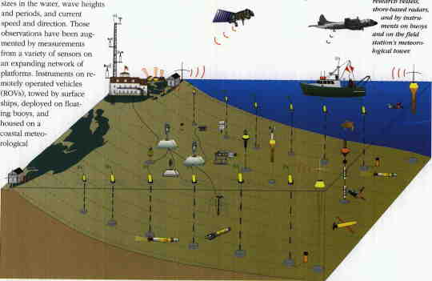
Goals for the Workshop: Background
Long history of interest in teaching with data

Slide 4
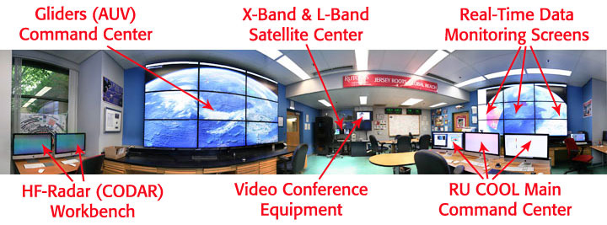
Coastal Ocean Observation Lab

Slide 5
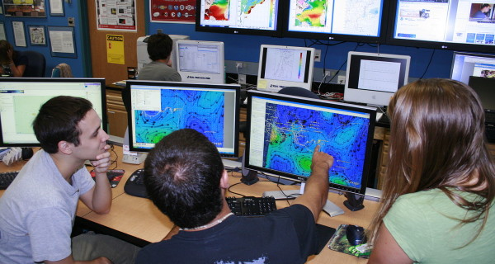
Coastal Ocean Observation Lab

Slide 6
Workshop Objectives
Crosswalk OOI Science themes presented in popular introductory textbooks used in oceanography courses. Compare themes and concepts in the OOI scientific themes document and popular published textbooks to triangulate where OOI data investigations/activities can be woven into existing courses.
Develop sample activities using OOI data/data viz tools and vet them with undergraduate professors.
Brainstorm how best to build a community of practice. Build long-term working relationships and collaborations on data investigation development.
Notes:
hands-on workshop focused on developing effective teaching with data practices using OOI

Slide 7
Concept Map
http://education.oceanobservatories.org/node/3882

Slide 8
What part are we focusing on?
Be data literate citizens
Obtain skills needed for STEM workforce
Notes:
Saturday 8:30am
We started some great conversations last night of the many components and challenges that we face in teaching with data, but also with a great articulation of our large scale goals…. We want to take a few moments to explain the scope and goals of the data activities that we developed using OOI data and that we will spend the majority of today talking about.

Slide 9
What part are we focusing on?
Be data literate citizens
Obtain skills needed for STEM workforce
Increase data literacy
Increase interest in STEM
Deeper understanding of concepts
Notes:
Saturday 8:30am
…so that students will…

Slide 10
What part are we focusing on?
Be data literate citizens
Obtain skills needed for STEM workforce
Increase data literacy
Increase interest in STEM
Deeper understanding of concepts
Using authentic data in teaching
Visualizing data in a user friendly way
Enabling students to interactively engage with data in learning
Notes:
Saturday 8:30am
…so of the many things that are needed in teaching with data, we are focusing on these three aspects…

Slide 11
Primary objective = to augment/complement what you are already doing to teach the content
Notes:
Saturday 9:15am
The primary objective of the data activities is to augment/complement what you all as professors of your classes are already doing in terms of teaching the content and science practice skills. For this workshop there is less of an emphasis on students using authentic data to mimic the process of science in its entirety, but rather we are offering the opportunities for students to engage with user-friendly interactive graphs of authentic data to encourage critical thinking, expose them to real messy data, and broaden their understanding of data and data skills. This is the first workshop that is 100% OOI data, and while that is a big feat, it is also important to note that we therefore will not be using any learner-generated data as part of the data activities.

Slide 12
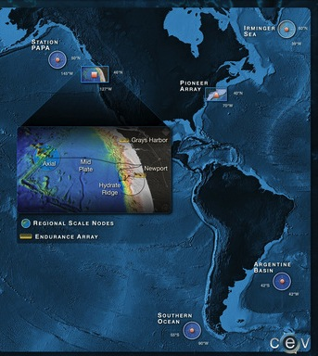
How we got here…
Notes:
Saturday 9:15 am
Now that we have talked about why it is important to teach with data as well as the common struggles we all face with using data with our students, let’s step into what we will be doing this weekend. We wanted to take a moment to explain how we got to where we are today.
As Sage mentioned last night, one of the objectives of the OOI is to provide authentic data for use in undergraduate teaching…

Slide 13

How we got here…
Notes:
Saturday 9:15 am
…but the question is how to add it into what is already being done in our courses…

Slide 14
How we got here…
Table of Contents Crosswalk with OOI data
Notes:
Saturday 9:15 am
…so we started from the beginning and looked through all of the subsections and topics in an Introduction to Oceanography course and mapped out where OOI data could potentially be added into a course. But there are 16 Chapters in the book and OOI data is relevant to components of 12 of them, so we needed to narrow it down some more…

Slide 15
How we got here…
Table of Contents Crosswalk with OOI data
Chapter 13. Biological Productivity and Energy Transfer
Notes:
Saturday 9:15 am
…we chose the to focus on biological productivity for this effort in integrating OOI data into Introduction to Oceanography courses for two main reasons: (1) although we sometimes don’t like to admit it living things catch the attention of the general public and thus our undergraduate students more than physical aspects of our planet, and (2) there is an inaccurate presumption by some that the OOI is only delivering physical oceanography data. Additionally, and selfishly, Janice and I both have backgrounds in biological oceanography/marine biology so it fit well there too ☺

Slide 16
Chapter 13. Biological Productivity and Energy Transfer
What is primary productivity?
What kinds of photosynthetic marine organisms exist?
How does regional primary productivity vary?
How are energy and nutrients passed along in marine ecosystems?
What issues affect marine fisheries?
Notes:
Saturday 9:15am
When looking at Chapter 13, there are three subsections in which OOI data could be used, so now it was time to find the data…

Slide 17
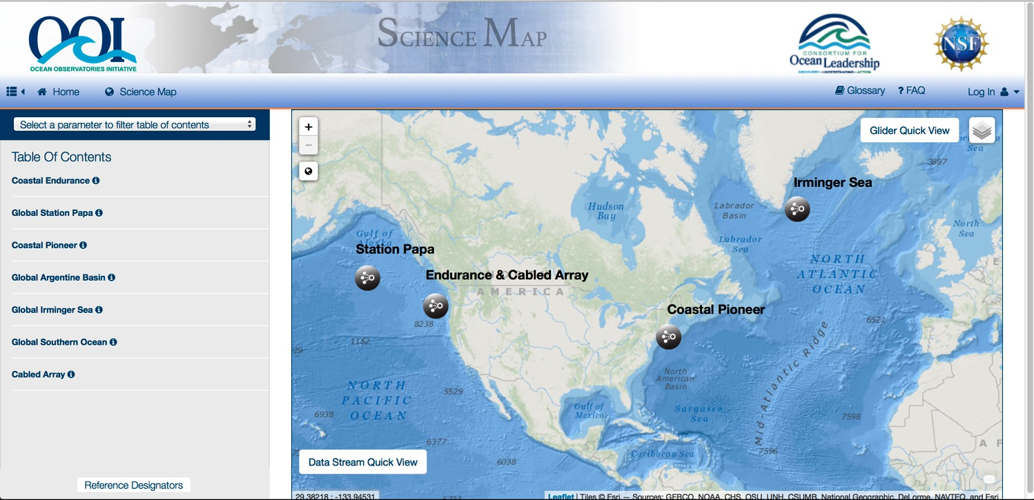
How found the data…
Notes:
Saturday 9:15am
…to develop activities to augment the students understanding of the concepts while also building data literacy skills, we then dove into the OOI data portal to determine what data there was…

Slide 18
How found the data…
3-wavelength Fluorometer
2-wavelength Fluorometer
Photosynthetically Available Radiation
Nitrate
Notes:
Saturday 9:15am
…there are four instruments that collect data relevant to primary productivity.

Slide 19
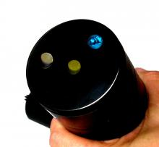
How found the data…
3-wavelength Fluorometer
2-wavelength Fluorometer
Photosynthetically Available Radiation
Nitrate
Notes:
Saturday 9:15am
Due to data availability and the topics we were trying to develop activities around, we chose the 3-wavelength flourometer as the instrument we would use data from for the activities.

Slide 20
Exploring Primary Productivity with Data – Data Activity Context
Notes:
Saturday 10:00am
We are about to explore the developed data activities, but a few notes before we dive into them…

Slide 21
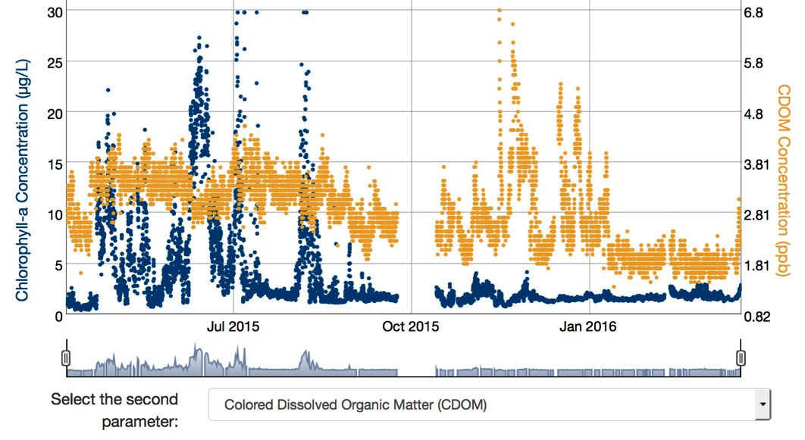
Exploring Primary Productivity with Data – Data Activity Context
Authentic data exposure
Notes:
Saturday 10:00am
The data activities are all using authentic data (binned to the hour to make the data sets manageable) to act as data exposures, meaning the data is actually messy…it does not present a pretty picture of a clearly found concept, but rather is true to form of what data actually are

Slide 22

Exploring Primary Productivity with Data – Data Activity Context
Authentic data exposure
Designed to be used for 15-20 minutes
Notes:
Saturday 10:00am
They were designed for students to engage with the data and answer a few prompting questions to assist the students in their exploration and analysis of the data

Slide 23

Exploring Primary Productivity with Data – Data Activity Context
Authentic data exposure
Designed to be used for 15-20 minutes
Collaborative/cooperative application
Notes:
Saturday 10:00am
They should also be completed in a collaborative and cooperative space among the users so to foster as much success and engagement with the data. This is true if they are being used as an in-class drop-in activity or as a homework assignment. Students working through their understanding of the data together is important.

Slide 24
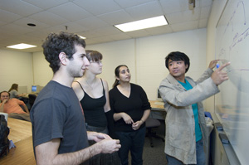
Exploring Primary Productivity with Data – Data Activity Context
Authentic data exposure
Designed to be used for 15-20 minutes
Collaborative/cooperative application
Need surround/supports
from you!
Notes:
Saturday 10:00am
And finally, these are not stand alone activities to teach an entire concept. There is background information and skills that your students will need to know before they can do them successfully. They do not present a conclusion about a concept, but rather push students to look at data and ask questions about a concept in deepen their understanding of the concept. Therefore, in whatever form you use the activities – be it in class or as homework – you will need to develop and provide a surround and supports for your students. You know your students best and the way in which you will implement the activity, so this way you get to tailor the surround to work best for your situation and students, while we have done the data lift for you.

Slide 25
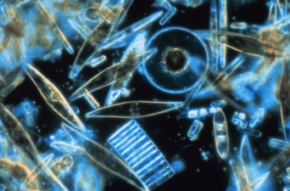
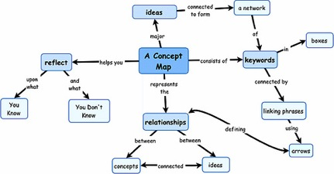
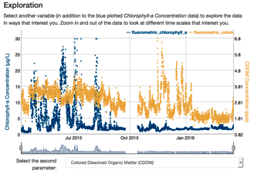
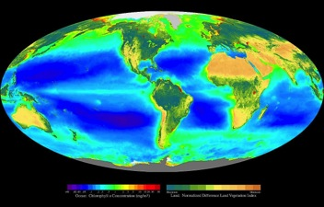
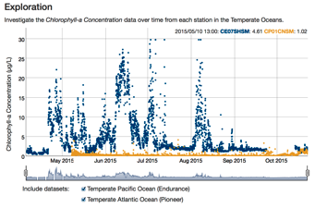
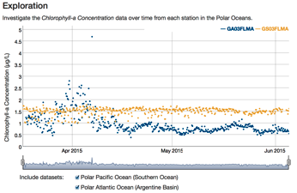
Exploring Primary Productivity with Data
Concept Map 1
Concept Map 2
Data Activity 1
Data Activity 4
Data Activity 2
Data Activity 3
Notes:
Saturday 10:00am
We will split into four groups. One will focus on the Measurement of Primary Productivity (13.1.1), another on Productivity in Middle Latitude Oceans (13.3.3), another on Productivity in Polar Oceans (13.3.1), and one is on Comparing Regional Productivity (13.3.4). All four use a interactive data tools to explore the data, and thus concept. We will work in small groups to do all of data activities first as learners, to mimic our learners, and then afterwards will share with one another what the activity entailed so that everyone has an idea of all four activities. We will spend a lot of time later today talking about how we would use and modify these as instructors, so now is our chance to dive in like our students do.

Slide 26
Exploring Primary Productivity with Data
http://education.oceanobservatories.org/productivity/
Concept Map 1
Concept Map 2
Data Activity 1
Data Activity 4
Data Activity 2
Data Activity 3
Notes:
Saturday 10:00am
So we need to make 4 groups of 2-3 people each and then assign data activity to each group. Then go to this website to find the activity.

Slide 27
Exploring Primary Productivity with Data
Concept Map 1
Concept Map 2
Data Activity 1
Data Activity 4
Data Activity 2
Data Activity 3
Notes:
Saturday 10:30am
Now that we have each had the opportunity to walk through the activity as our learners would, let’s share with one another what the different data activities are and start to think about how using such activities could help students develop their own understanding about the topic through data rather than us telling them about the pattern in a lecture or reading. Each group will have roughly 10 minutes to explain the activity, provide initial thoughts about it and answer questions from peers.

Slide 28

Designing instruction based on how people learn

Slide 29
Session Goals
Reflect on the common experiences we just engaged in that placed us in “learner” role
Share a model for designing instruction used across diverse professional learning experiences
Focus on learning research as underpinning of effective teaching & lesson design
Reflect on what you might take away for your own practice.

Slide 30
How can experiences be designed to support learning?

Slide 31
Quick Write
Think about a time you really learned something
How did you learn it?
What did it take for you to really learn it?
What was it about this prior learning experience that made it work for you?
Notes:
Take a few responses

Slide 32
Summary
multi-faceted experiences - provided more than one opportunity to learn, different approaches were used
creating a desire or will to learn about something
teaching a topic to someone else
having the chance to practice and extend the learning
delaying providing an answer to help keep learner curious
touching or doing something
sharing thoughts and discussing ideas with others
accessing and connecting to prior knowledge
Notes:
Finish slide 5 within 10 minutes
Point out any patterns or similarities that you notice. Many of the things just mentioned are examples of accepted principles for designing effective learning experiences.
We are living in an era when a lot is known from extensive research about how people learn. As educators we can use these understandings to inform the way we design learning experiences.
It can be very useful to think about and plan for the stages of learning when we're designing lessons for students.

Slide 33
Turn & Talk
Think for a moment about the data activity you engaged in & then turn to someone that experienced the same activity & discuss:
What do you think the instructor’s learning goals would be for engaging students in the activity?
How would you describe what the role(s) of the instructor could be in the activity?
Be ready to share something from your discussion
Notes:
Start this slide within 10 minutes of starting session
Remind participants that the data activities were designed to be student-driven, but there are a variety of ways the instructor could assign/intro/support them and provide more opportunities for meaning-making.

Slide 34
Small group discussion
Join a group of 4 composed of 1p from each different activity.
Think about the data activity you engaged in & then discuss with your group:
Would you put the activities into a sequence/order?
Why or why not? What are the affordances & challenges of doing so?
What order would you put the activities in?
What were some of the reasons you thought about for putting the activities in a particular order?
Notes:
Tell them they don’t have to try to get all 4 activities in order at once.
Brief share-out – push on the reasons
During debrief – an affordance would be to incorporate different types of activities into class
Explain that others have also thought a lot about the ideal sequencing of science learning activities & the associated learning goals, and developed a useful model for teaching.

Slide 35
Learning Cycle
The learning cycle is based on research about how people learn, and has been used for decades to design science and other learning activities in ways that help students to learn.
Notes:
Distribute handout. Explain that others have also thought a lot about the ideal sequencing of science learning activities & the associated learning goals, and developed a useful model for teaching.

Slide 36
The Learning Cycle
Invitation
Exploration
Concept Invention
Application
Reflection
Notes:
Briefly explain each phase, referring to their handout.

Slide 37
Match up a data activity with a phase of the learning cycle
Work with your group of 2-3p that engaged in the same data activity.
Which phase does the activity you engaged in match up with?
How does the activity accomplish the goals of that phase?
Which phase would you say is a good match with the concept map?
Notes:
Before trying to match each of the 4 data activities with the learning cycle phase it best illustrates, we have some more prompts that may help us to recognize each phase.

Slide 38
Design of data activities
 | Questions to ask about the goals of the activity | Name of Data Activity – what did we do? Which phase does it match up with? How does it accomplish the goals of that phase?
Invitation | How does it get students interested in learning about the topic? How does it help them access their prior knowledge?
Exploration | How will learners have experiences that provide concrete observations and discoveries to help them make sense of the topic?
Concept Invention | How will learners be encouraged to struggle with their understanding and negotiate their ideas with others?
Application | How will learners authentically apply what they've learned to a new situation or context?
Reflection | How will learners think back on the learning process to help reinforce their understandings, and make them better learners in the future?
Notes:
First column provides more prompts to help us in the match-up. Quickly read each cell. Remind them to work with their group of 2-3p that engaged in the same data activity and to match the activities they did into the phase it best represents. In column 2 we’ll put the name of the activity and what they engaged in while doing the activity that accomplished the goal of that phase.
Elicit participant ideas before showing next slide. During debrief ask: Do you agree that the activity accomplishes the goals for the _________phase of learning? If not, why? Ask for reasoning, encourage participation in discussion, and probe for alternative ideas. Focus the discussion on their reasons.

Slide 39
Design of data activities
 | Questions to ask about the activity | Name of Data Activity – what did we do? Which phase does it match up with? How does it accomplish the goals of that phase?
Invitation | How does it access students prior knowledge and get them interested in learning about the topic? | Create a concept map of primary productivity to access and connect to prior knowledge.
Exploration | How will learners have experiences that provide concrete observations and discoveries to help them make sense of the topic? | Data figures of measurements of primary productivity. User changes time & four variables to make general observations & ask questions to try to make sense of the patterns.
Concept Invention | How will learners be encouraged to struggle with their understanding & negotiate their ideas with others? | Data figures of primary productivity at different latitudes (2 activities). Users are given two data sets to observe & are challenged to interpret patterns w/in a defined location & time (with other users).
Application | How will learners authentically apply what they've learned to a new situation or context? | Data figures of primary productivity from different regions. User provided choices & makes own determination about how to explore the data to understand differences in primary productivity.
Reflection | How will learners think back on the learning process to help reinforce their understandings, and make them better learners in the future? | Revise original concept map of primary productivity. Compare how ideas have changed and discuss what helped to deepen their understanding of how to teach/connect primary productivity concepts/topics.
Notes:
What did we do in the activities that reflects the goals of the phase?
Activities might include:
For exploration activity: learners explore a challenge question, a model and ideas with peers
For concept invention activity: Instructor provides directions for talking with peers, guides observations & provides reading. Volunteer explains & instructor probes for evidence and alternative ideas.
For application activity: where might this phenomena occur in the natural world? What did you learn about the concept of _______?

Slide 40
Drawbacks of focusing on only one phase
Many educators focus on the area of the Learning Cycle with which they are most comfortable
Focusing solely on one phase of the cycle may mean neglecting or rushing other important phases of the cycle
Leads to fewer opportunities for students to engage in different kinds of activities that can be used to
capture student interest, connect to prior knowledge, explain their understanding, and increase persistence to make sense of the phenomenon.
Notes:
Which one do you think faculty are most often comfortable with?
Different kinds of activities can be used to capture their interest, connect to prior knowledge, explain their understanding, and increase their persistence to make sense of the phenomenon.

Slide 41
Reminders for designing effective lessons using the learning cycle
Start off with invitation rather than with concept invention
Allow students to think about and explore a topic before introducing concepts and vocabulary
Make sure to include time for application & reflection (even if it happens after class).
Include opportunities throughout for students to engage in meaning-making about phenomenon.
Notes:
Sometimes an activity doesn’t work as effectively as it might because the learning cycle wasn’t taken into account.
We may be most familiar with concept invention from our years of schooling, and as you might surmise, many educators focus on the area of the learning cycle with which they are most comfortable. Which one do you think faculty are most often comfortable with?
Introducing concepts and vocabulary too early means that the students are then memorizing words that they aren’t interested in and don’t understand.
Remind participants that there is nothing explicit associated with the activities that reminds/encourages instructors to facilitate student learning or meaning making while engaging in the data activities. Tell them that they will have time later today and again on Sunday to tailor the data activities, add more surround and place them within the context of their classroom and teaching about primary prod.

Slide 42
Exploring Primary Productivity with Data & the Learning Cycle
Invitation Concept Map
Reflection Concept Map
Exploration Data Activity
Application Data Activity
Concept Invention Data Activity 1
Concept Invention Data Activity 2
Notes:
Saturday 12:15pm
In designing the activities with the learning cycle in mind, this was how we mapped it out. However, it is important to note that while we developed at least one activity for each stage of the learning cycle, the activities do not need to all be used together.

Slide 43
Reflect on the session
Write about something you would like to remember about designing learning experiences according to the learning cycle.
Notes:
Allow participants a few minutes to quietly reflect on and write about what they learned from the session.
Optional second prompt: Describe specific things you can do to make your teaching more learning cycle-based.

Slide 44
Lunch ☺

Slide 45

Demonstration of OOI Vocabulary Navigator
Annette deCharon, University of Maine
annette.decharon@maine.edu
deCharon, A., L. Smith, and C. Companion. 2015. Characterizing Complex Marine Systems & Technology Using Visualized Vocabularies. Marine Technology Society Journal 49(4): 53-63, http://dx.doi.org/10.4031/MTSJ.49.4.2.

Slide 46
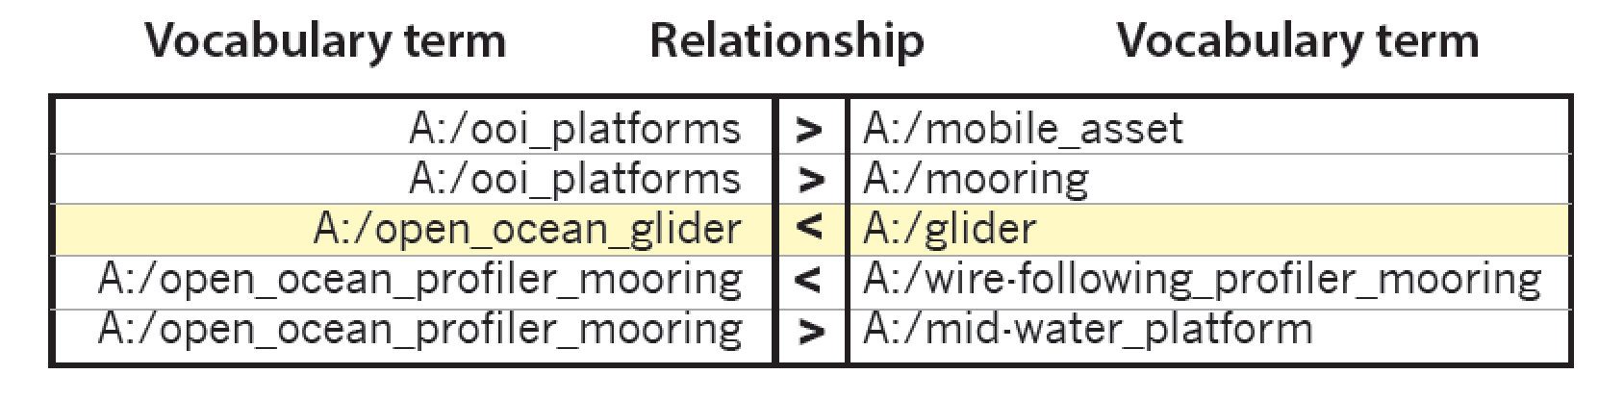
Background
To help make sense of a very complicated marine system, a computer sciences-based organizational structure (i.e., ontology) has been employed to characterize the Ocean Observatories Initiative (OOI)

Slide 47
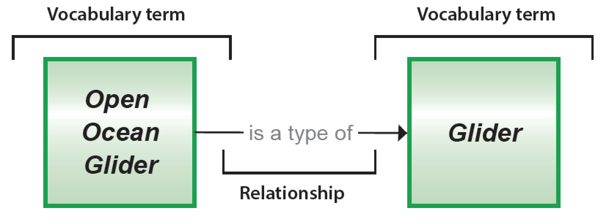
Background
To help make sense of a very complicated marine system, a computer sciences-based organizational structure (i.e., ontology) has been employed to characterize the Ocean Observatories Initiative (OOI)

Slide 48
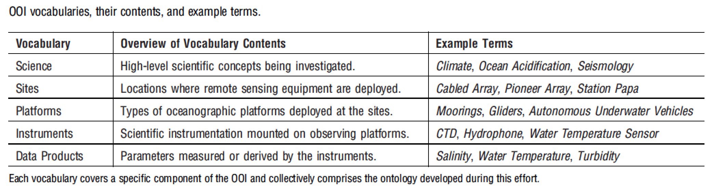
Background
We have constructed five linked vocabularies that include terms, descriptions, and images, define the overall system

Slide 49
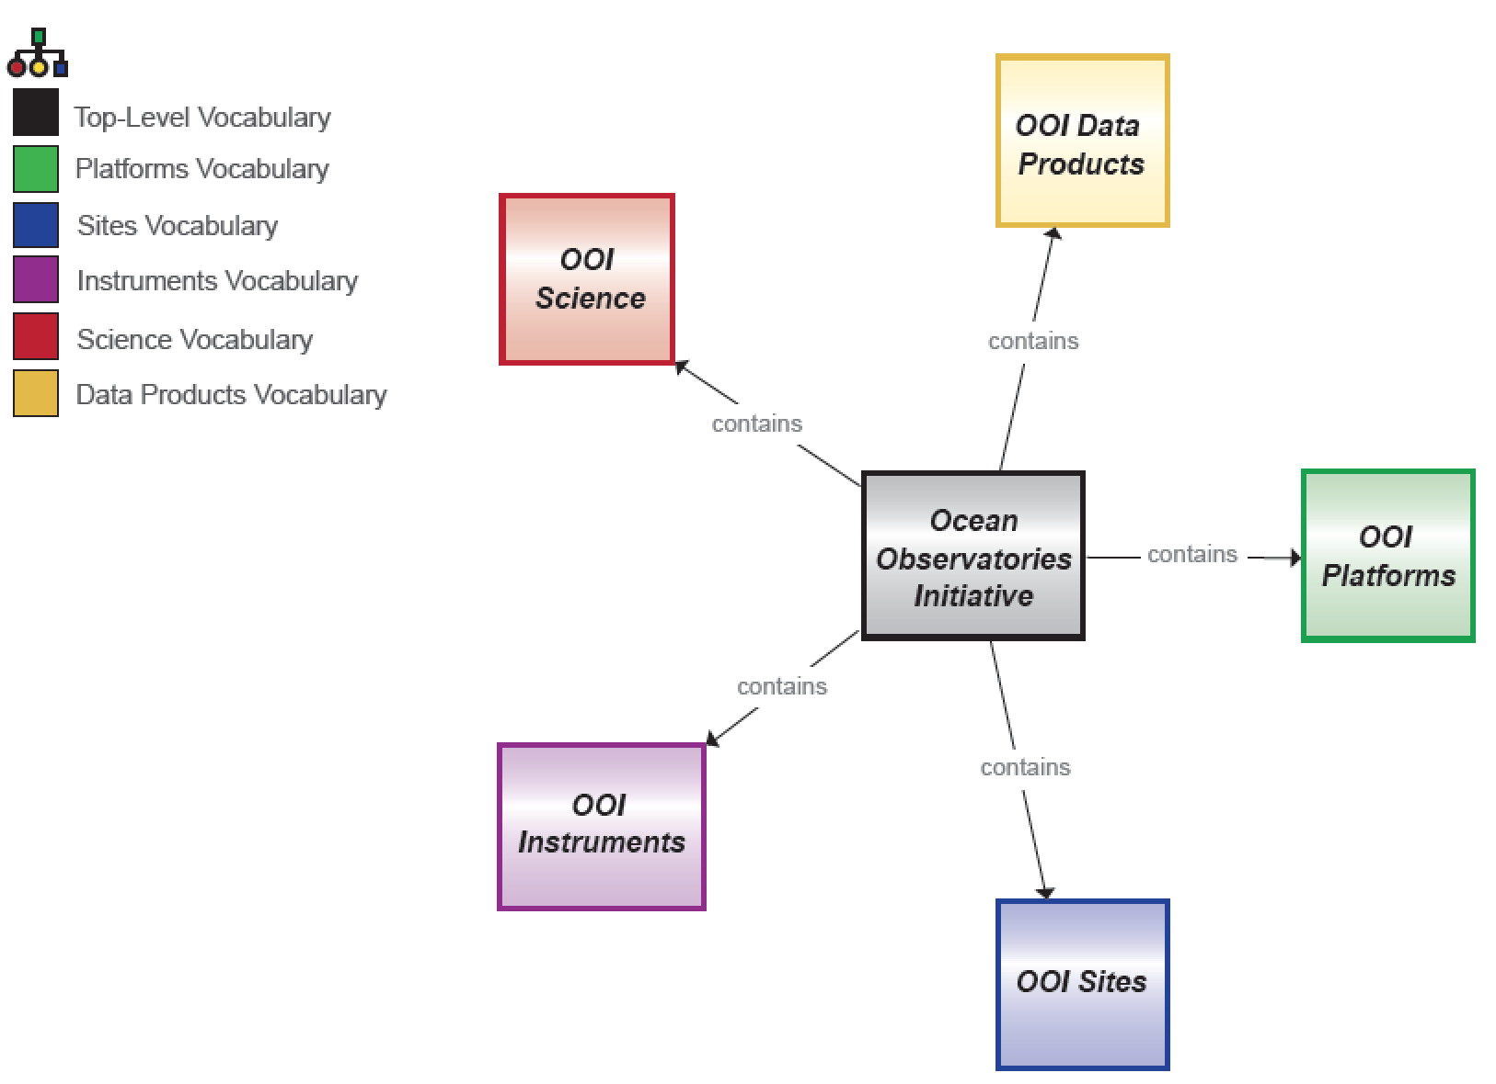
Background
Given the importance of visual representations in learning, an associated interactive “Vocabulary Navigator” has been developed

Slide 50
Background
Design of the vocabularies and their visualizer are based on principles related to the needs of the target audience (undergraduate students) such as placing information in a broader context and promoting self-directed discovery
Speaking of discovery... let's learn how to navigate OOI Vocabularies!

Slide 51
Let's Get Started...
http://education.oceanobservatories.org
Log in
Use pull-down menu to "Create a Concept Map"
Click on "Vocabulary Navigator" at top and enter the search term, "Primary Production"
Notes:
http://education.oceanobservatories.org
username: epetest
password: eperocks

Slide 52
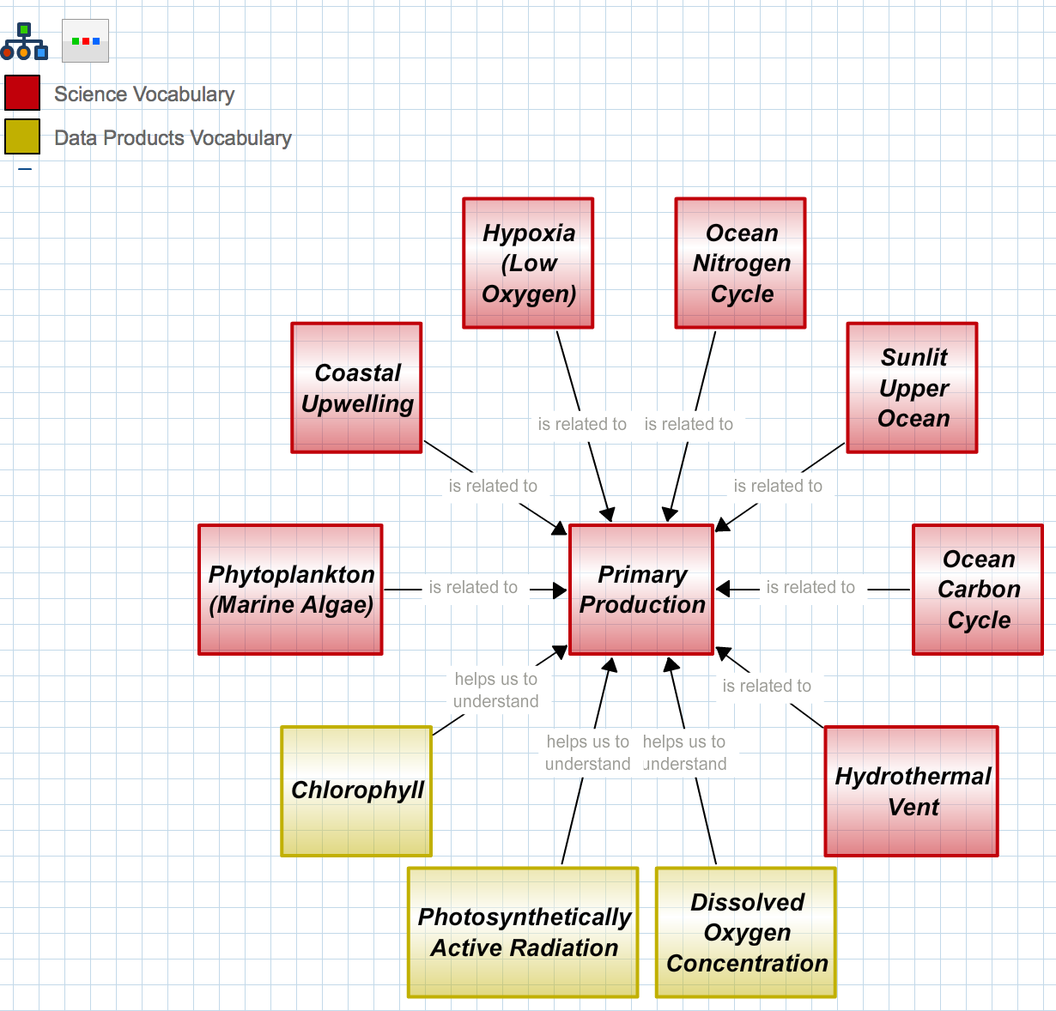
Primary (1°) Production
This map pulls info from two vocabularies: Science & Data Products

Slide 53
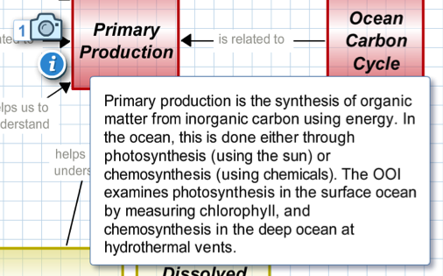
1° Production: Description
Click camera icon to reveal image(s) attached to the concept
Click "i" for description

Slide 54
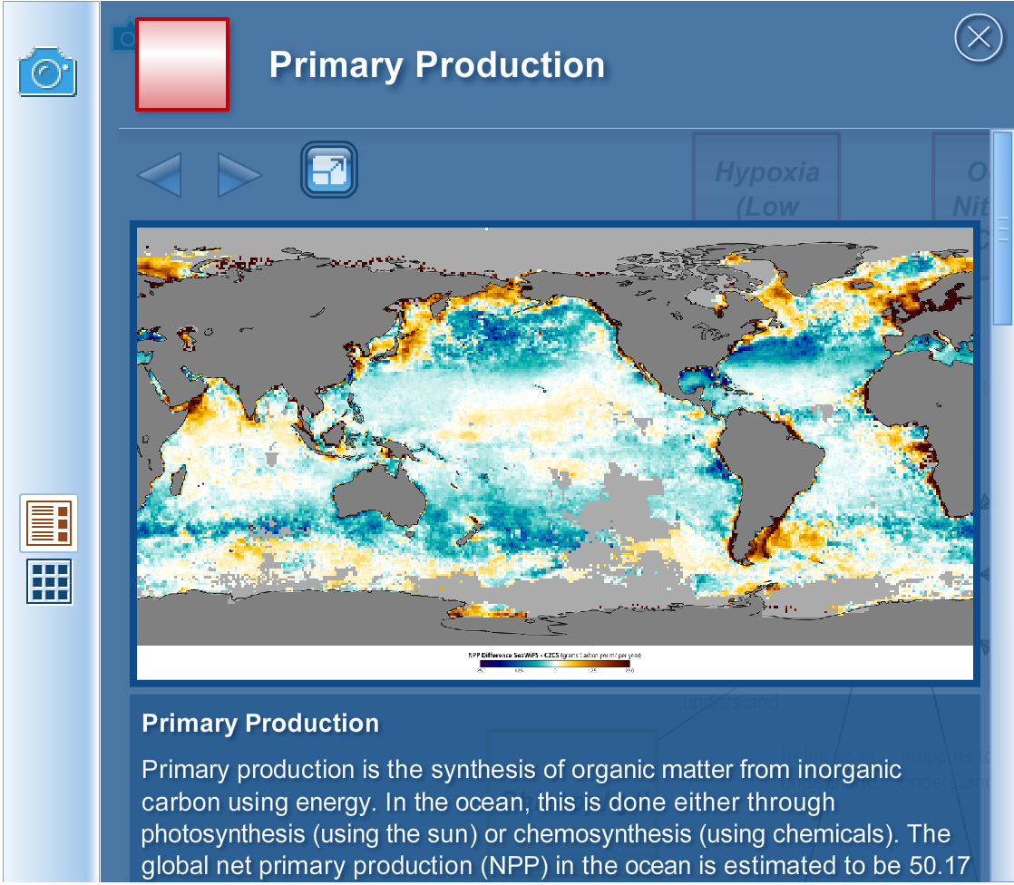
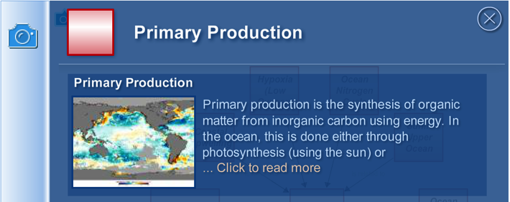
1° Production: Image
"Read more" reveals detail (e.g., full caption)
"Stand Alone" button shows image in full screen mode
"Stand Alone"
"Read more"

Slide 55
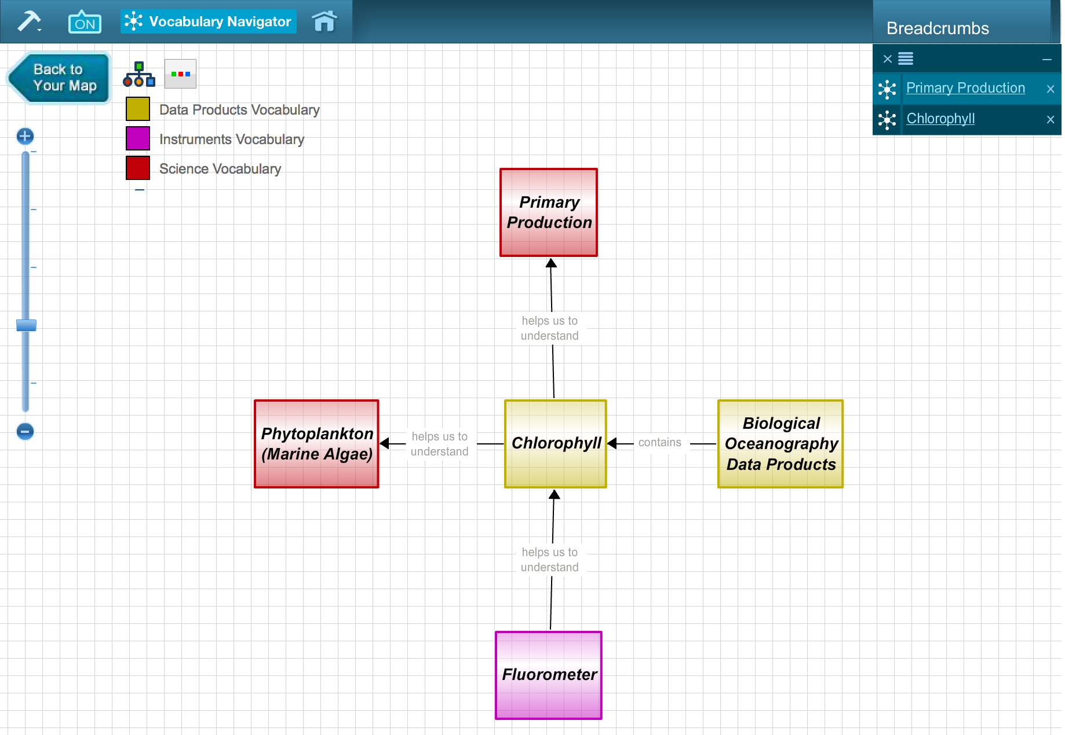
Bread Crumbs
Click on "Chlorophyll" to recenter map
Bread crumbs
New vocabulary: Instruments
Click on "Fluorometer" to re-center map

Slide 56
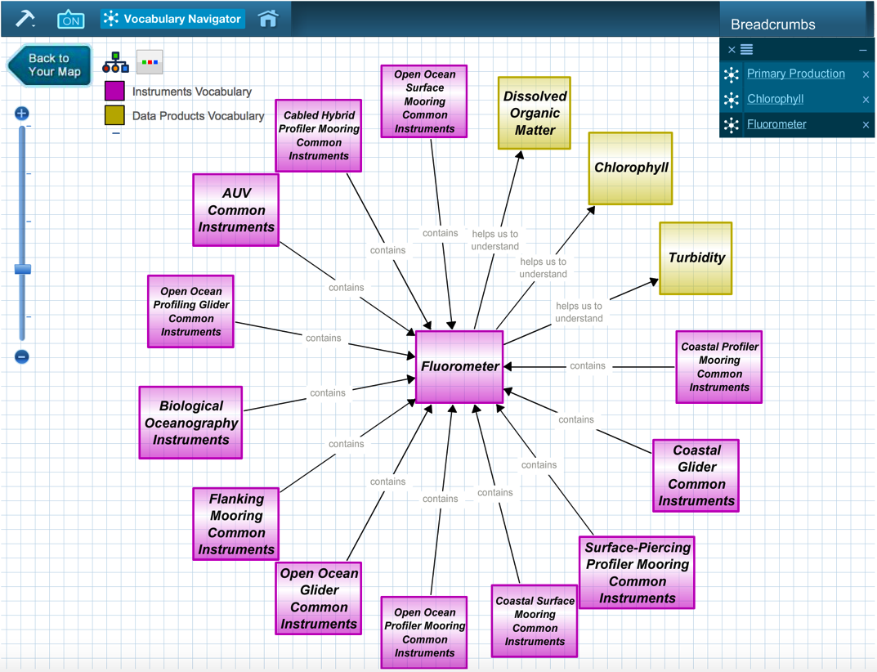
Fluorometer
OOI products related to fluorometer data
This view shows the diversity of OOI instruments that include a fluorometer

Slide 57
Copy into a Concept Map
Click "Back to Your Map"

Slide 58
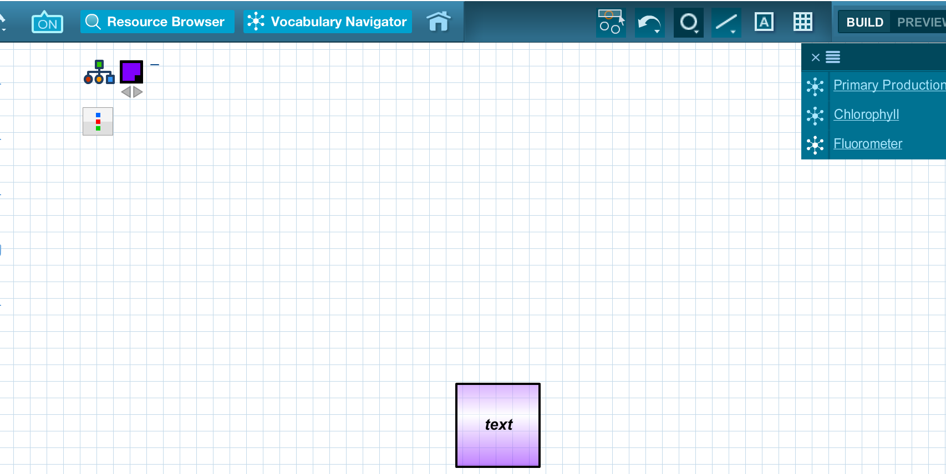
Copy into a Concept Map
You now have a "clean slate" to create a concept map that starts with a pre-populated vocabulary map!
Click and drag
Click and drag on the breadcrumb that you'd like to import into your map space...

Slide 59
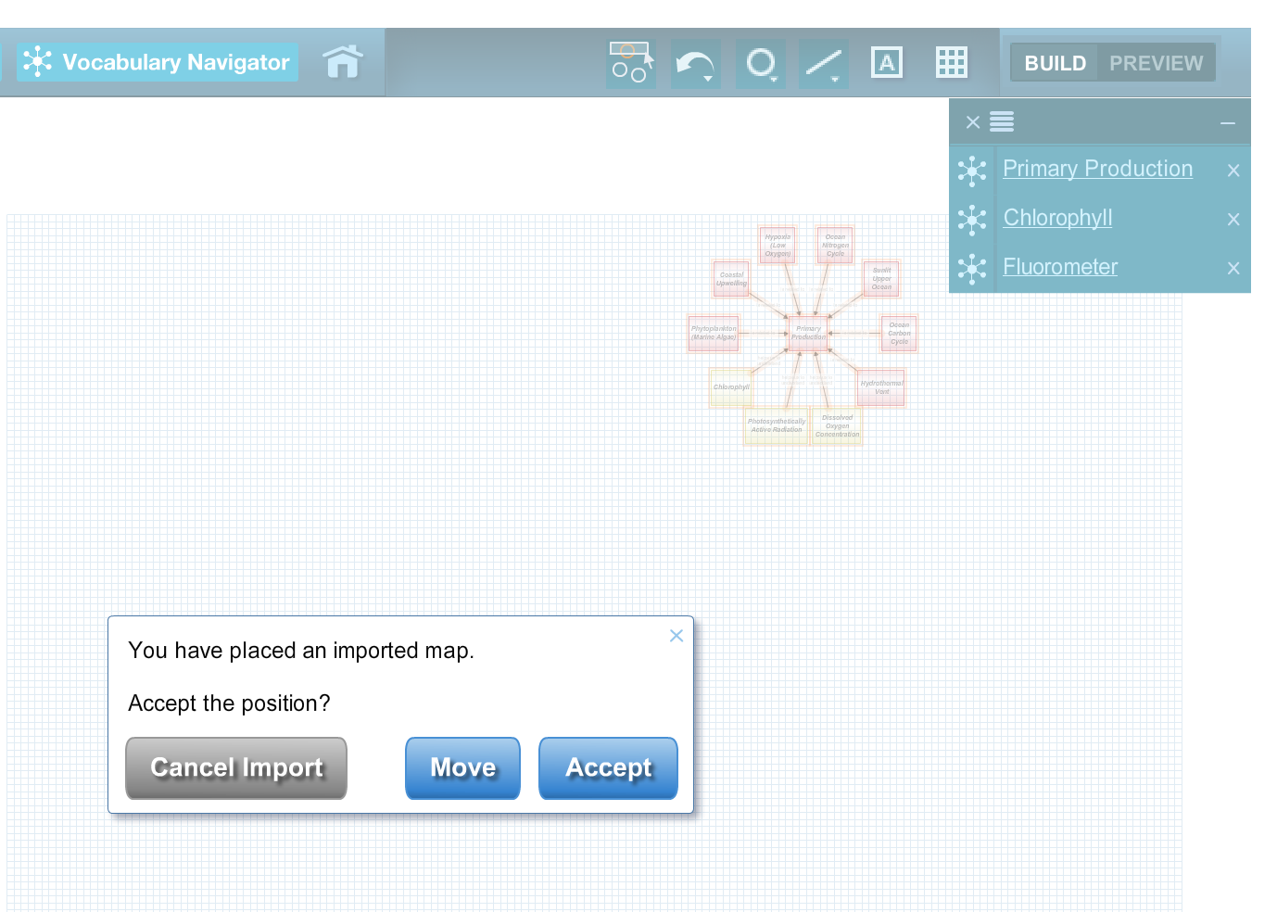
Copy into a Concept Map
Click "Accept" to save as a Concept Map

Slide 60
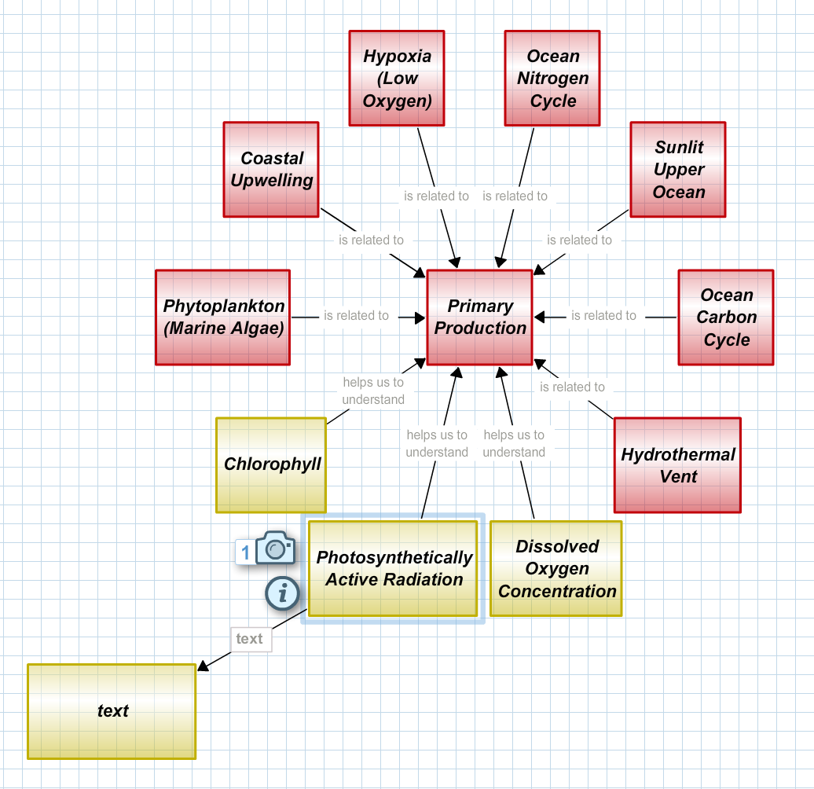
Copy into a Concept Map
Map still has assets attached!
Can add new concepts!

Slide 61
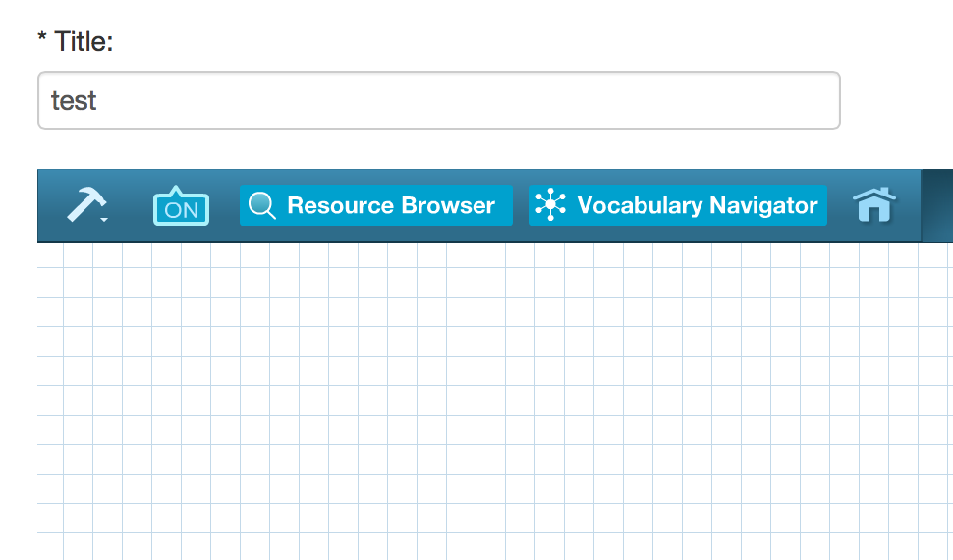
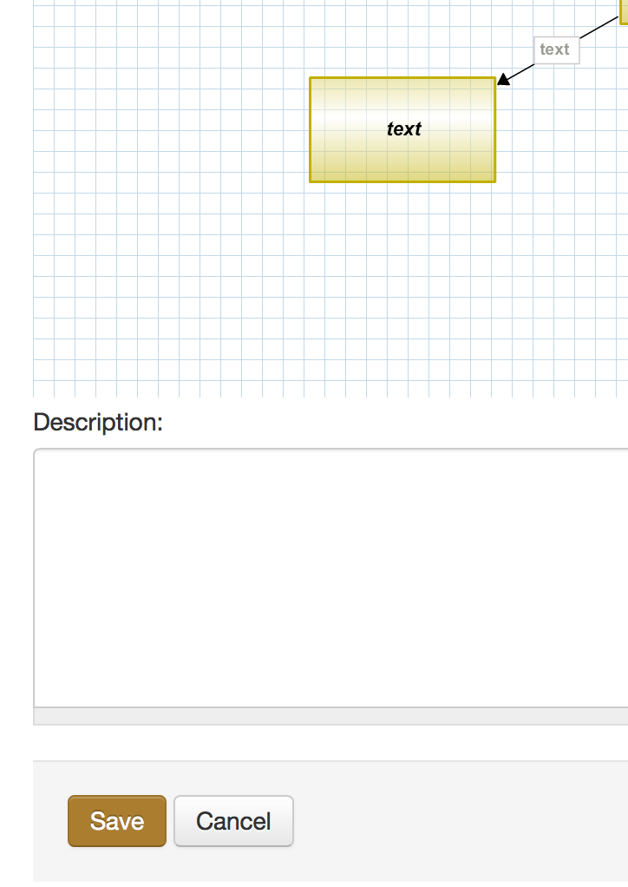
Save Your New Concept Map
At top, assign a name to your map
At bottom, click "Save"

Slide 62
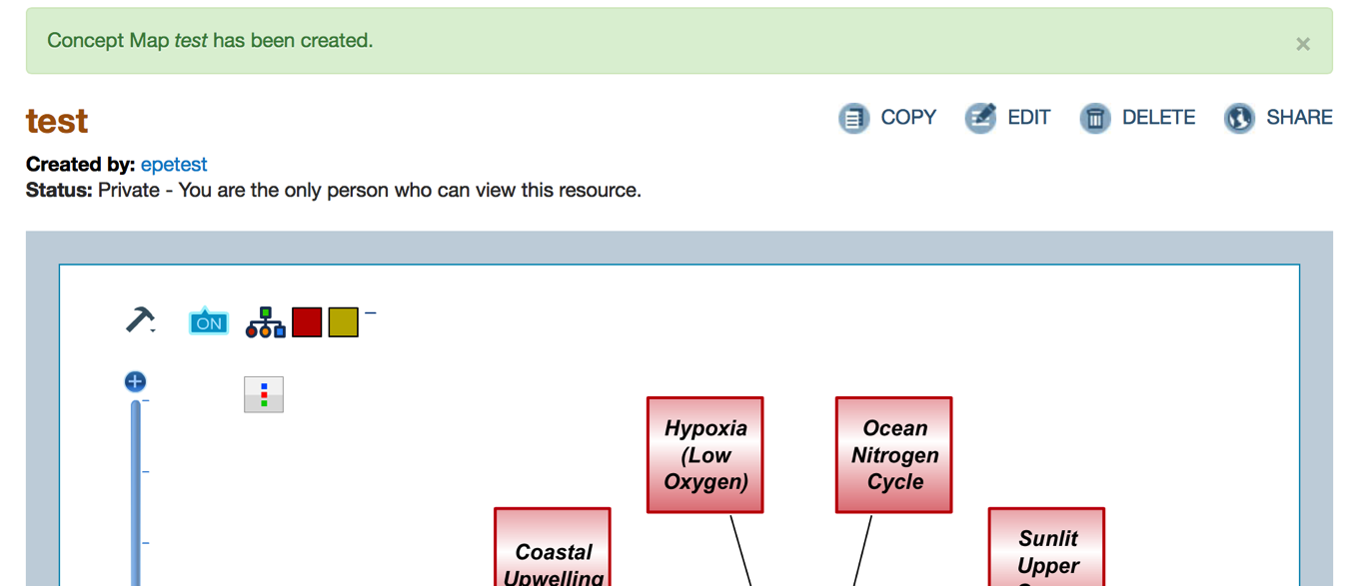
Edit Your New Concept Map
Click "Edit" to return to further refine your map

Slide 63
Conclusion
Are you ready to try it?

Slide 64
Designing Educational Visualizations
Sage’s slides

Slide 65
How Learning Happens
Notes:
We will focus today on how we have translated research about learning into classroom practice.

Slide 66
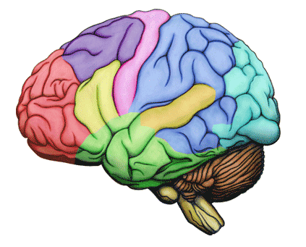
Quick Write
How do you think learning happens?
What are your ideas about what facilitates and supports learning?

Slide 67

Foundational Ideas on Learning
Learning is an active process to construct understanding.
Learning builds on prior knowledge.
Learning occurs in a complex social environment and is a social activity.
Learning should be situated in an authentic context.
Learning is affected by motivation and cognitive engagement.
Notes:
Introduce these foundational ideas on learning. Have them keep them in mind for the next part of the activity (the jigsaw)

Slide 68
Research Discussion
Form groups of 6 people
Pair up with someone in your group and both of you individually read the same research card
Discuss with your partner:
What do you think each idea means?
How do these ideas apply to your experiences as a learner?
Share & discuss with your Group of 6
2-3 big ideas from your discussion
How might these ideas apply to you as a college instructor?
Determine 2-3 big ideas/highlights (disagreements, agreements, aha’s, etc) from your discussion to share with whole group
Notes:
1. Explain Discussion Jigsaw and Research Cards and break participants up into expert groups. Let them know there are three bodies of literature represented in the Research Cards; two students in each group will be assigned to review and discuss the same research card in depth with each other and become “experts.” After the expert group discussions, everyone in the small group of six will then discuss all three sections of the Research Cards. The “experts” will lead the discussion for their respective sections.
2. Distribute Research Cards and assign groups.
3. Participants read section individually. Tell them they will have about 5 minutes to individually read their assigned section before discussing the ideas with their partner. Suggest they might circle parts they wonder about, underline those ideas they think are important, and write questions in the margin.

Slide 69
Synthesis of Discussion
People construct understanding of complex ideas over a long period of time.
Learners don’t acquire concepts simply by having someone tell them the content, or even by doing hands-on activities.
Learners must encounter multiple learning experiences that encourage them to
question their assumptions;
engage in discussion about their ideas;
make connections to and build on their prior knowledge;
apply their new understandings in different contexts.

Slide 70
How can experiences be designed to support learning?

Slide 71
The Learning Cycle
Invitation
Exploration
Concept Invention
Application
Reflection
Notes:
Remind them of learning cycle very briefly

Slide 72
Provide opportunities for students to struggle with meaning making.
The heart of the learning cycle is providing opportunities for the learner to struggle to make sense of discoveries, explorations, and phenomena.
Engage students with questions and ideas, and encourage them to explain to peers what’s going on.
Prompt students to make connections and describe and/or discover the relationship between ideas.
Meaning making can take place at every phase of the learning cycle. You want students continually asking: "What is going on here?" “Maybe it can be explained like this…”
Notes:
Remind participants that there is nothing explicit associated with the activities that reminds/encourages instructors to facilitate student learning or meaning making while engaging in the data activities. Perhaps they would like to add a surround to the activities to push on this idea that meaning-making can occur during each phase, or add a more explicit role for the instructor as a facilitator, or more opportunities for students to explain their ideas to each other. [Next slide provides some examples].

Slide 73
The Learning Cycle supports how learning happens
National Research Council’s 2000 report How People Learn: Brain, Mind, Experience, and School
Key Finding #1 states: “Students come to the classroom with preconceptions about how the world works. If their initial understanding is not engaged, they may fail to grasp the new concepts and information, or they may learn them for purposes of a test but revert to their preconceptions outside the classroom.”
Key Finding #2 states: “To develop competence in an area of inquiry, students must (a) have a deep foundation of factual knowledge, (b) understand facts and ideas in the context of a conceptual framework, and (c) organize knowledge in ways that facilitate retrieval and application.”
Key Finding #3 states: “A metacognitive approach to instruction can help students learn to take control of their own learning by defining learning goals and monitoring their progress in achieving them.”
Notes:
It's clear from research that students must actively create their own conceptual understanding.
Learning does not occur through passive transmission from instructor to student. In other words, if an instructor tells a piece of information, the information cannot be simply passed on from the instructor's brain to the student's.
Students must actively compare new ideas, and in some cases combine them, with their own prior knowledge, ideas, and pre-conceptions.

Slide 74
Revisit Quick Write about Learning
What do you want to remember about what facilitates and supports learning?
Notes:
Add a line under your quick write and write additional ideas or revisions under the line – things you want to remember.

Slide 75
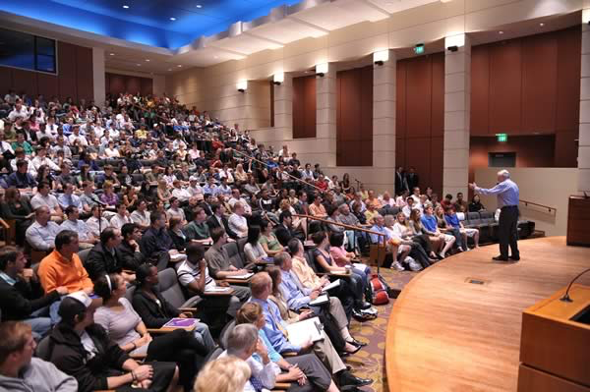

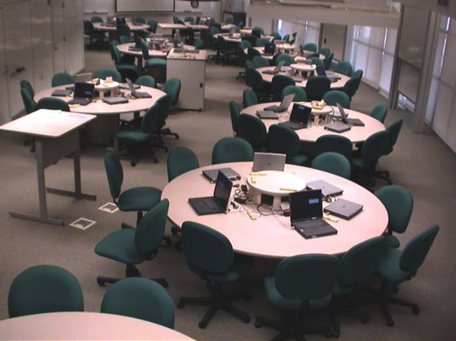
Where do we integrate data in teaching?
Course Syllabus
Lecture Online Active Learning

Slide 76
Data-enhanced learning experiences..
including activities in which students collect and interpret their own data and/or those in which they explore research databases to answer questions.
Data enhanced learning experiences can:
Prepare students to address real-world complex problems;
Develop students’ ability to use scientific methods, including consideration of the values and ethics of working with data;
Teach students how to critically evaluate the integrity and robustness of data or evidence and of their consequent interpretations or conclusions; and
Provide training in scientific, technical, quantitative, and communication skills.
Manduca and Mogk 2002. Using Data in Undergraduate Science Classrooms (Grant NSF-0127298)

Slide 77
Exploring Primary Productivity with Data & Design Elements
Invitation Concept Map
Reflection Concept Map
Exploration Data Activity
Application Data Activity
Concept Invention Data Activity 1
Concept Invention Data Activity 2
Notes:
Saturday 2:45pm
There was a method to the madness in how we designed the activities and what features we included to help the students engage with the data in a supported way…

Slide 78
Exploring Primary Productivity with Data & Design Elements
One data set is locked, user only needs to select another to compare data sets
List of data is prepopulated
The user can adjust the time frame, and the scale bar automatically adjusts
The data easily plot onto the same graph, no need to look between graphs
Invitation Concept Map
Reflection Concept Map
Exploration Data Activity
Application Data Activity
Concept Invention Data Activity 1
Concept Invention Data Activity 2
Notes:
Saturday 2:45pm
… for example for the exploration data activity we incorporated aspects such as these to provide a scaffolded experience to the student to help them start to understand the data.

Slide 79
Exploring Primary Productivity with Data & Design Elements
Two data sets are provided to help user make observations across multiple locations
Able to only look at one location at a time
Same set-up of graph and variable that was looked at previously to minimize orientation needed
Invitation Concept Map
Reflection Concept Map
Exploration Data Activity
Application Data Activity
Concept Invention Data Activity 1
Concept Invention Data Activity 2
Notes:
Saturday 2:45pm
… whereas for the concept invention we incorporated these aspects to help the students take their understanding to the next level…

Slide 80
Exploring Primary Productivity with Data & Design Elements
Multiple data sets provided, but user has to make decision of what to turn on and off for analysis
List of data is prepopulated
User has to look more among graphs to do data analysis
Invitation Concept Map
Reflection Concept Map
Exploration Data Activity
Application Data Activity
Concept Invention Data Activity 1
Concept Invention Data Activity 2
Notes:
Saturday 2:45pm
… and finally for the application data activity we incorporated aspects such as these to provide opportunities for students to demonstrate their learned comfort with the data and to determine based on their interests which aspects of the concept they are interested in pursuing further.

Slide 81

Modifying Data Activities
Notes:
Saturday 2:45pm
These data activities were designed to be flexible and adaptable for the needs of the users. Now we get to dive in and make suggestions of how to adjust the activities to make them enhanced/better versions for you to use with your students. We are going to work again in the small groups that we were in previously and here are paper copies of the activities to mark up and write your ideas on to make sure they are captured so we can make the changes next week. We will work until 3:45 or so and then after the break will come back together to share with one another how it went and what modifications were suggested (5 minutes per group).

Slide 82
Brainstorm where to integrate data activities into teaching
Al’s slides

Slide 83
Questions for Professors
What were you expecting from the activities when you signed up?
What do you feel the activities offered?
How was what the activities offered different from what you were expecting?

